Slide 1
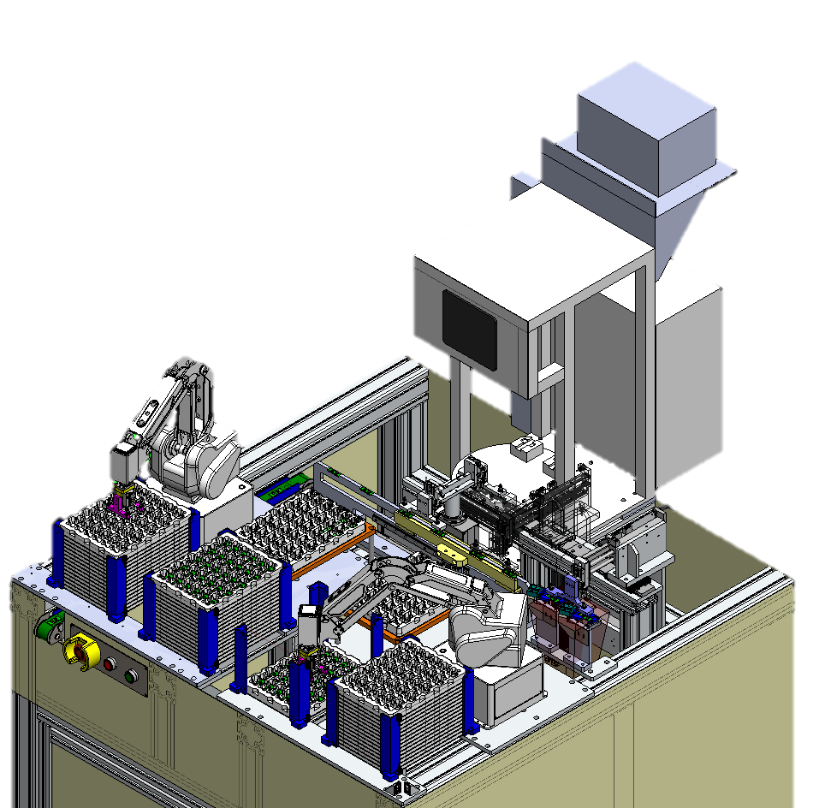
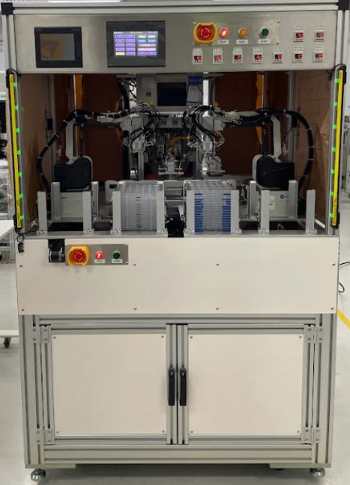
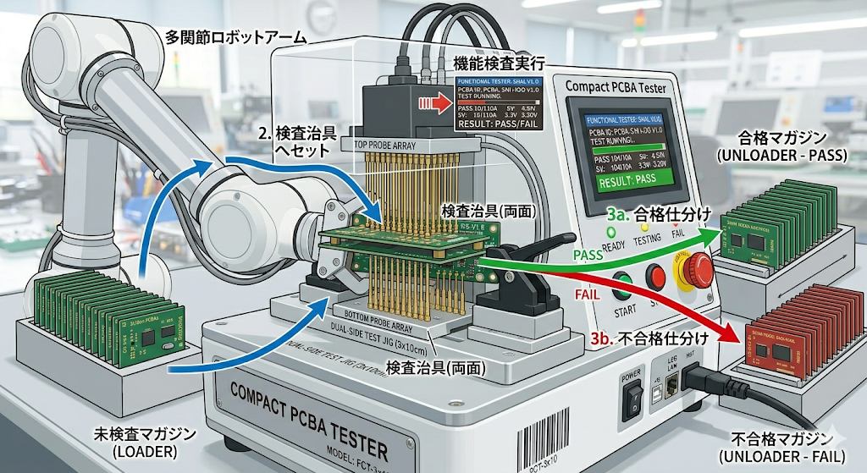
XNF FCT Automation [design image]
Pick-up from tray
FCT fixture (CH1)
Take out
and
set to Pass tray
Magazine tray (Before test)
Magazine tray (Test pass)
FCT fixture (CH2)
Magazine tray (Test fail)
MA model FCT tester
PCBA set to empty CH
Take out
and
set to Fail tray
2CH auto FCT tester diagram
(AI help image )
「一方通行」(Direction one side flow)
FCT Fixture 2 type (for L-model, for R-model)
or,,, 4 type (NFC-L, Non-NFC-L, NFC-R, Non-NFC-R)

